Slide 1
Team Ven0m
Project presentation

Slide 2
What is NFT?
NFT: Non-Fungible Token - digital asset for unique item ownership via blockchain.
Represents authenticity of digital/physical assets (art, music, videos, virtual real estate).
Bought/sold using cryptocurrency.

Slide 3
Common Uses of NFT
Artistic Expression: NFT galleries showcase and sell digital artwork as unique tokens, providing a platform for artists.
Collectibles: NFT galleries facilitate the creation and trade of digital collectibles, from virtual cards to in-game items.
Digital Real Estate: Platforms in NFT galleries allow trading and showcasing of virtual land in virtual worlds and metaverse projects.
Music and Videos: Musicians and creators tokenize their work for fans to purchase unique copies, potentially unlocking special benefits.

Slide 4
Common Uses of NFT (pt.2)
Virtual Goods and Items: NFT galleries act as decentralized marketplaces for trading virtual goods and items in online games.
Tokenizing Physical Assets: Some NFT galleries explore tokenization of physical assets, linking ownership to digital representations on the blockchain.
Authentication and Proof of Ownership: NFTs serve to authenticate digital content, providing proof of ownership and provenance through blockchain.
Monetization for Creators: NFTs enable direct monetization for creators, cutting out intermediaries and potentially earning royalties through secondary sales

Slide 5
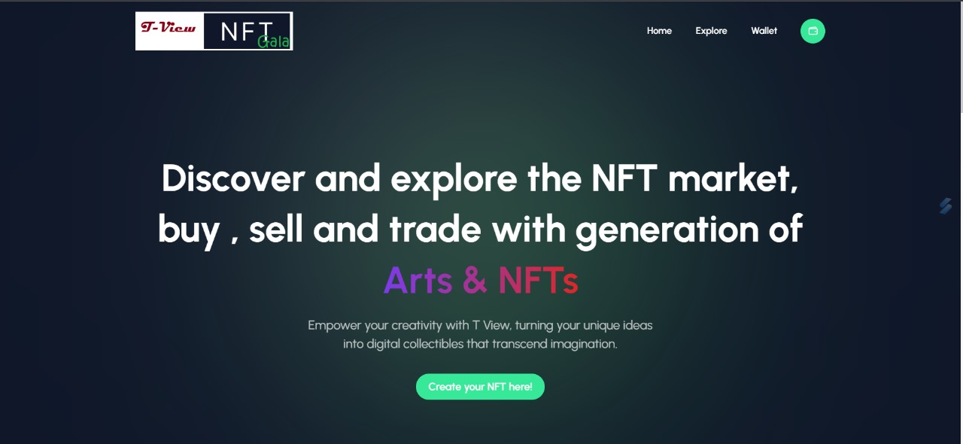

Slide 6
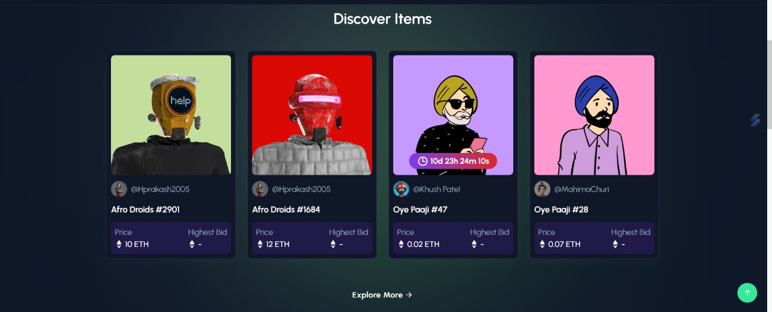

Slide 7
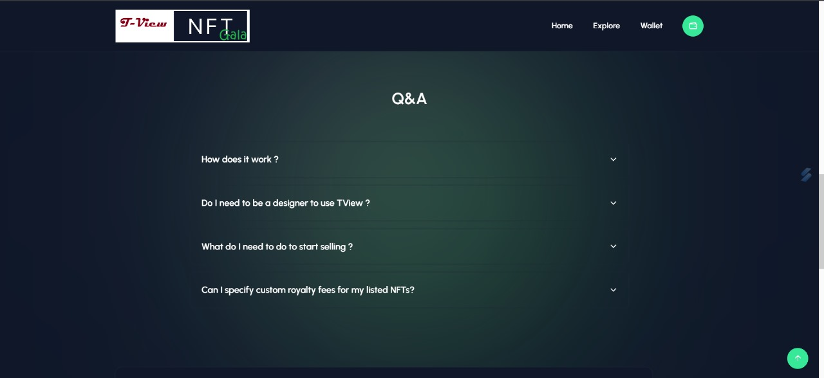

Slide 8
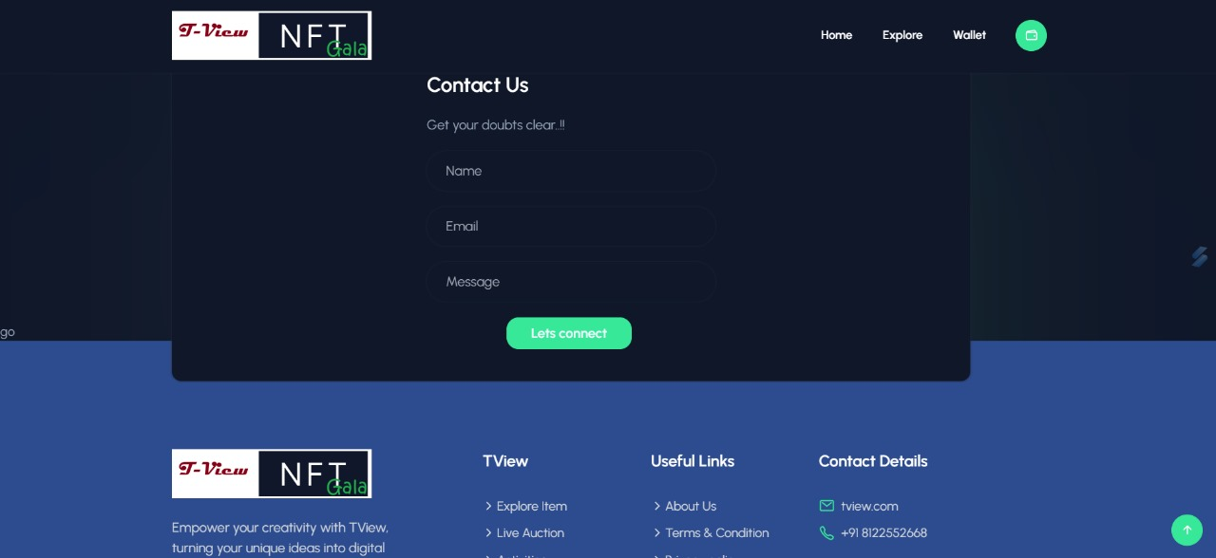

Slide 9
THANK YOU
VINEET KUMAR
G S CHARAN
RAGHAVENDAR.V
R. SRIVATHSAN
ADITYAN S

